Slide 1
Radial Basis Function Networks (PART 1)

Slide 2
Introduction
Now, we take a different approach by viewing the design of an ANN as a curve-fitting (approximation) problem in a high dimensional space
From this viewpoint, learning is same as finding a surface that best fits to the training data
Criterion for “best fit” is measured in some statistical sense
This viewpoint is the motivation behind radial-basis functions

Slide 3
Introduction
Hidden units in an ANN can be thought as providing a set of functions that constitute an arbitrary basis for the input patterns
These are called radial-basis functions
A radial-basis function (RBF) network is made up of 3 layers with entirely different roles
Input layer has source nodes
2nd layer (the only hidden layer) applies a nonlinear transformation from the input space to the hidden space
Output layer is linear and it supplies the response of the network to the activation pattern (signal) applied to the input layer
In most applications, the hidden space has a high dimension
A pattern-classification problem cast in a high dimensional space is more likely to be linearly separable than in a low dimensional space
Hidden space dimension is directly related to the input-output mapping approximation capacity of the network

Slide 4
Chapter Organization
Construction of an RBF network
Part 2
Supervised learning as an hypersurface reconstruction problem
Tikhonov’s regularization theory
Regularization networks
Generalized RBF networks
Solving XOR problem with an RBF network
Regularization parameter
Part 3
Approximation properties of RBF networks
Comparison of RBF networks and multilayer perceptrons
Part 4 (omitted)
Kernel regression estimation (omitted)
Part 5
Learning strategies for RBF networks
Example computer experiment

Slide 5
Chapter Organization
Construction of an RBF network
Part 2
Supervised learning as an hypersurface reconstruction problem
Tikhonov’s regularization theory
Regularization networks
Generalized RBF networks
Solving XOP problem with an RBF network
Regularization parameter
Part 3
Approximation properties of RBF networks
Comparison of RBF networks and multilayer perceptrons
Part 4 (omitted)
Kernel regression estimation (omitted)
Part 5
Learning strategies for RBF networks
Example computer experiment

Slide 6
Cover’s Theorem on the Separability of Patterns
A RBF network solves a complex pattern classification task by transforming it into a high-dimensional space in a nonlinear manner
The justification for this comes from Cover’s theorem on the separability of patterns
A complex pattern-classification problem cast in a high-dimensional space nonlinearly is more likely to be linearly separable than in a low-dimensional space. (Cover, 1965)

Slide 7
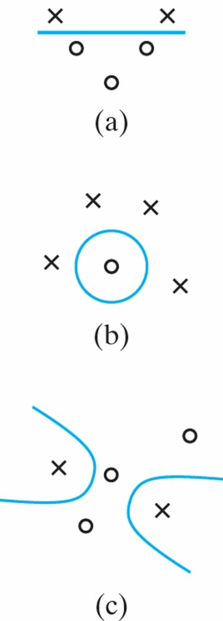
Figure 5.1 Three examples of φ-separable dichotomies of different sets of five points in two dimensions: (a) linearly separable dichotomy; (b) spherically separable dichotomy; (c) quadrically separable dichotomy.

Slide 8
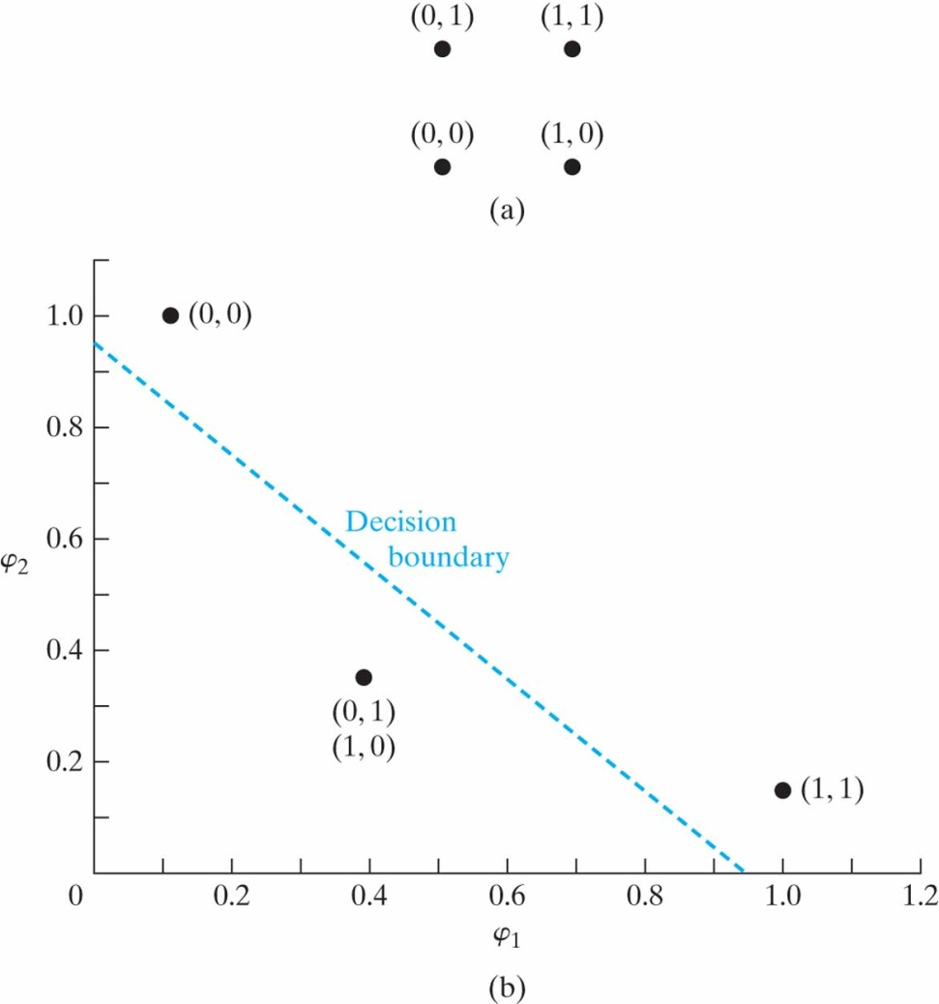
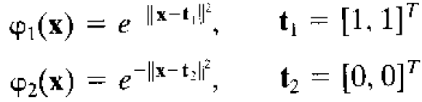
Cover’s Theorem on the Separability of Patterns
In some cases, using nonlinear mapping without increasing the dimensionality may be sufficient to produce linear separability
E.g. XOR problem
Define a pair of Gaussian hidden functions as follows

Slide 9
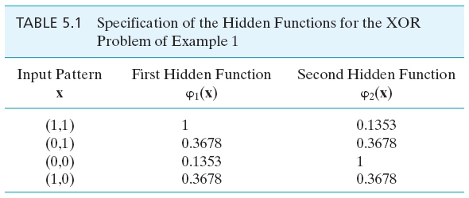
Cover’s Theorem on the Separability of Patterns

Slide 10
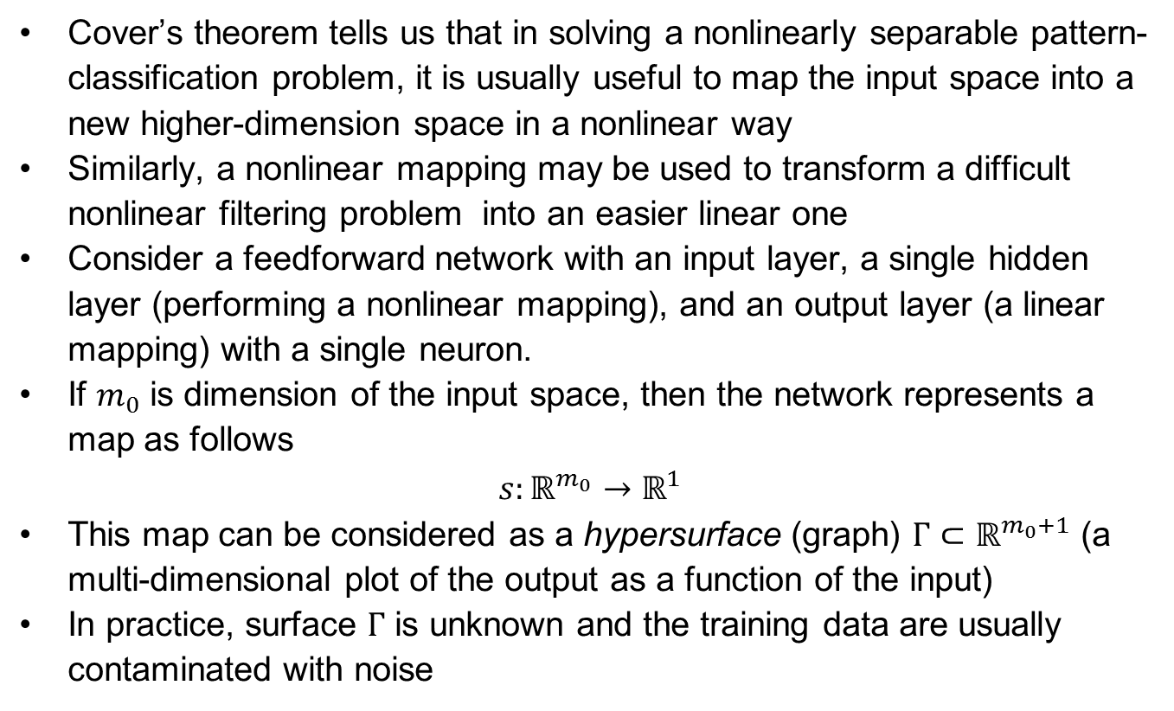
Interpolation Problem
Cover’s theorem tells us that in solving a nonlinearly separable pattern-classification problem, it is usually useful to map the input space into a new higher-dimension space in a nonlinear way
Similarly, a nonlinear mapping may be used to transform a difficult nonlinear filtering problem into an easier linear one
Consider a feedforward network with an input layer, a single hidden layer (performing a nonlinear mapping), and an output layer (a linear mapping) with a single neuron.
If $m_{0}$ is dimension of the input space, then the network represents a map as follows
$$s:ℝ^{m_{0}}→ℝ^{1}$$
This map can be considered as a hypersurface (graph) $Γ⊂ℝ^{m_{0}+1}$ (a multi-dimensional plot of the output as a function of the input)
In practice, surface $Γ$ is unknown and the training data are usually contaminated with noise

Slide 11
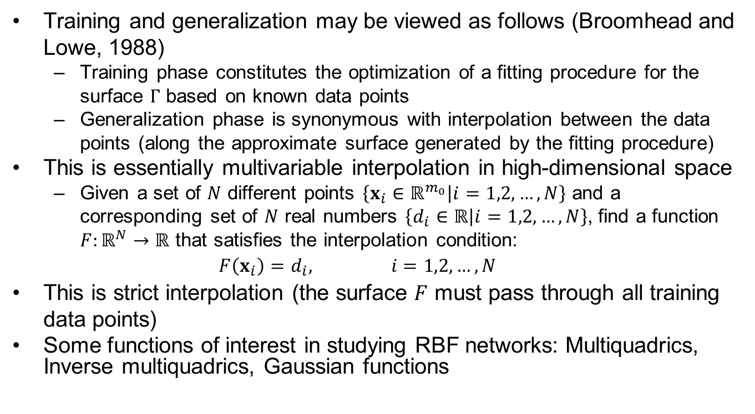
Interpolation Problem
Training and generalization may be viewed as follows (Broomhead and Lowe, 1988)
Training phase constitutes the optimization of a fitting procedure for the surface $Γ$ based on known data points
Generalization phase is synonymous with interpolation between the data points (along the approximate surface generated by the fitting procedure)
This is essentially multivariable interpolation in high-dimensional space
Given a set of $N$ different points $\left\{x_{i}∈ℝ^{m_{0}} | i=1,2,…,N\right\}$ and a corresponding set of $N$ real numbers $\left\{d_{i}∈ℝ | i=1,2,…,N\right\}$, find a function $F:ℝ^{N}→ℝ$ that satisfies the interpolation condition:
$$F\left(x_{i}\right)=d_{i}, i=1,2,…,N$$
This is strict interpolation (the surface $F$ must pass through all training data points)
Some functions of interest in studying RBF networks: Multiquadrics, Inverse multiquadrics, Gaussian functions

Slide 12
Chapter Organization
Construction of an RBF network
Part 2
Supervised learning as an hypersurface reconstruction problem
Tikhonov’s regularization theory
Regularization networks
Generalized RBF networks
Solving XOP problem with an RBF network
Regularization parameter
Part 3
Approximation properties of RBF networks
Comparison of RBF networks and multilayer perceptrons
Part 4 (omitted)
Kernel regression estimation (omitted)
Part 5
Learning strategies for RBF networks
Example computer experiment

Slide 13
Supervised learning as an ill-posed hypersurface reconstruction problem
When the number of data points in the training set is much larger than the number of degrees of freedom of the underlying physical process, and we are constrained to have as many radial-basis functions as data points, the problem is overdetermined (it may end up overfitting)
This may cause poor generalization, therefore, strict interpolation may not be a good strategy
The possibility of having insufficient training data and existence of noise (among other reasons) makes interpolation problem an ill-posed inverse problem
An ill-posed problem can be made a well-posed one by regularization

Slide 14
Chapter Organization
Construction of an RBF network
Part 2
Supervised learning as an hypersurface reconstruction problem
Tikhonov’s regularization theory
Regularization networks
Generalized RBF networks
Solving XOP problem with an RBF network
Regularization parameter
Part 3
Approximation properties of RBF networks
Comparison of RBF networks and multilayer perceptrons
Part 4 (omitted)
Kernel regression estimation (omitted)
Part 5
Learning strategies for RBF networks
Example computer experiment

Slide 15
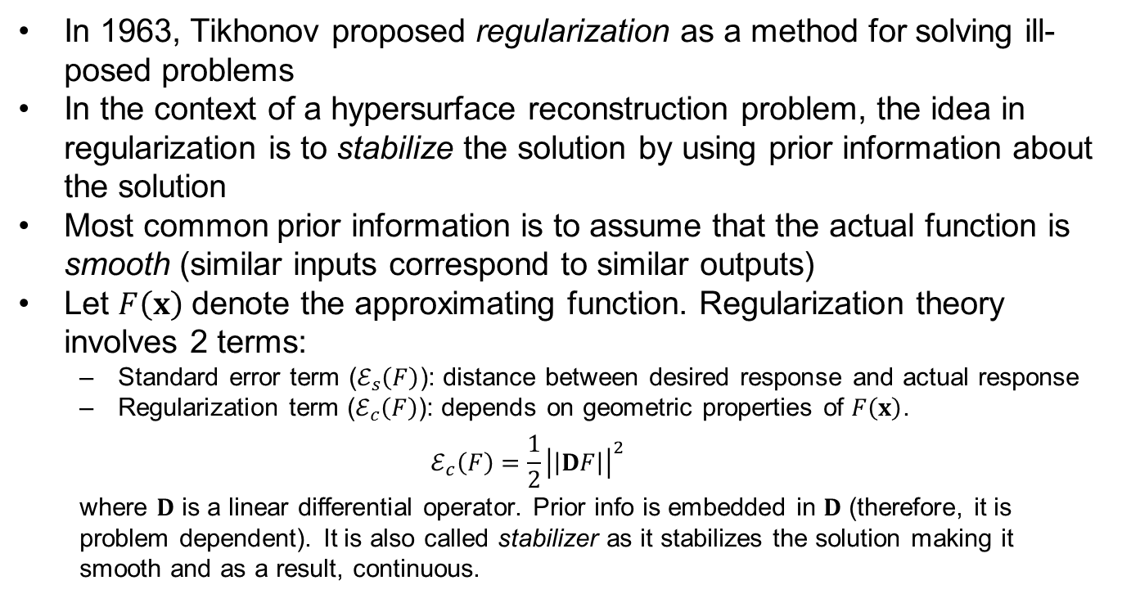
Regularization Theory
In 1963, Tikhonov proposed regularization as a method for solving ill-posed problems
In the context of a hypersurface reconstruction problem, the idea in regularization is to stabilize the solution by using prior information about the solution
Most common prior information is to assume that the actual function is smooth (similar inputs correspond to similar outputs)
Let $F\left(x\right)$ denote the approximating function. Regularization theory involves 2 terms:
Standard error term ($ℰ_{s}\left(F\right)$): distance between desired response and actual response
Regularization term ($ℰ_{c}\left(F\right)$): depends on geometric properties of $F\left(x\right)$.
$$ℰ_{c}\left(F\right)=\frac{1}{2}{\left|\left|DF\right|\right|}^{2}$$
where $D$ is a linear differential operator. Prior info is embedded in $D$ (therefore, it is problem dependent). It is also called stabilizer as it stabilizes the solution making it smooth and as a result, continuous.

Slide 16
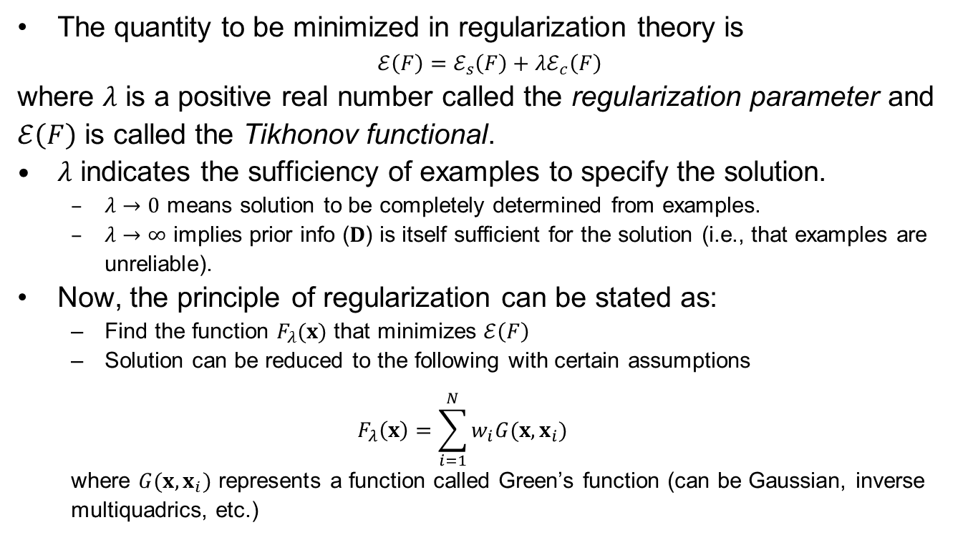
Regularization Theory
The quantity to be minimized in regularization theory is
$$ℰ\left(F\right)=ℰ_{s}\left(F\right)+λℰ_{c}\left(F\right)$$
where $λ$ is a positive real number called the regularization parameter and $ℰ\left(F\right)$ is called the Tikhonov functional.
$λ$ indicates the sufficiency of examples to specify the solution.
$λ→0$ means solution to be completely determined from examples.
$λ→∞$ implies prior info ($D$) is itself sufficient for the solution (i.e., that examples are unreliable).
Now, the principle of regularization can be stated as:
Find the function $F_{λ}(x)$ that minimizes $ℰ\left(F\right)$
Solution can be reduced to the following with certain assumptions
$$F_{λ}\left(x\right)=\sum_{i=1}^{N}{w_{i}G(x,x_{i})}$$
where $G(x,x_{i})$ represents a function called Green’s function (can be Gaussian, inverse multiquadrics, etc.)

Slide 17
Chapter Organization
Construction of an RBF network
Part 2
Supervised learning as an hypersurface reconstruction problem
Tikhonov’s regularization theory
Regularization networks
Generalized RBF networks
Solving XOP problem with an RBF network
Regularization parameter
Part 3
Approximation properties of RBF networks
Comparison of RBF networks and multilayer perceptrons
Part 4 (omitted)
Kernel regression estimation (omitted)
Part 5
Learning strategies for RBF networks
Example computer experiment

Slide 18
Learning Strategies
Fixed centers selected at random
simplest.
Assume fixed RBFs defining the activation functions of the hidden units.
Locations of centers can be chosen randomly from the training dataset.
For RBFs, we may employ an isotrophic Gaussian function whose standard deviation is fixed w.r.t. spread of centers
Self-Organized selection of centers
Problem with the previous one is that it may require a large training set for satisfactory performance
A hybrid learning process with 2 stages may be used to overcome this
Self-organized learning stage in which the purpose is to estimate appropriate center locations for RBFs in the hidden layer
Supervised learning stage which completes the design by estimating the linear weights of the output layer
Batch processing can be used but an adaptive (iterative) approach is preferred
A clustering algorithm such as k-means clustering is used for the self-organized learning process

